Slide 1
Group 20 Level 4-5
imdcgd214 Managing Games Production
imdcgd111 Group Project
Ross Warren (S176778)
Max Carter (S175573)
Jake Seaman (S183883)
Jack Fuller (S176802)

Slide 2
Brief
Constraints:
2D Environment
Physics based mechanic
Adversarial
Played on a single device
Symmetric
Simple rules

Slide 3
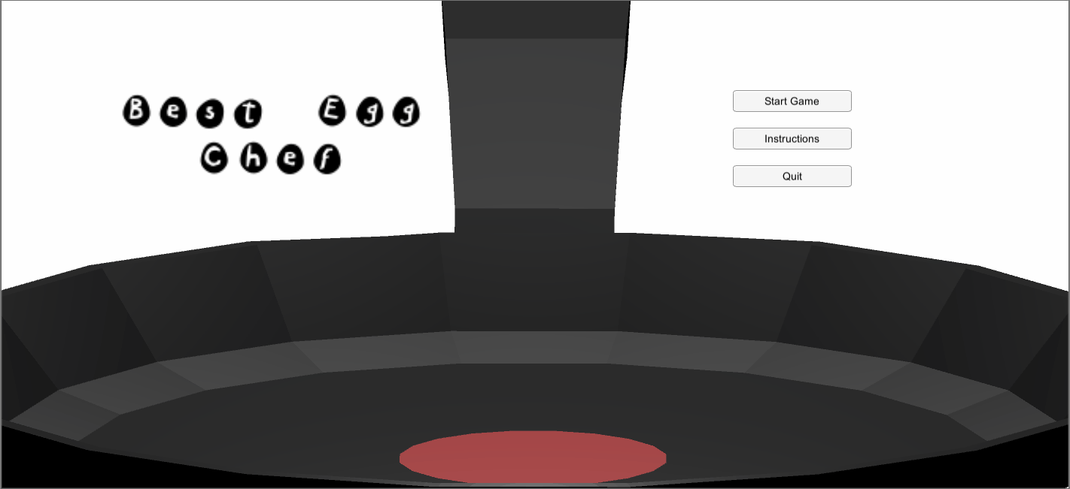

Our Game – Sunny Slide Up
Tagline – Princess Layer is busy laying eggs. As her apostles, it’s your job to bounce eggs into your basket to send the eggs down to her people.
Platforms – iOS & Android

Slide 4
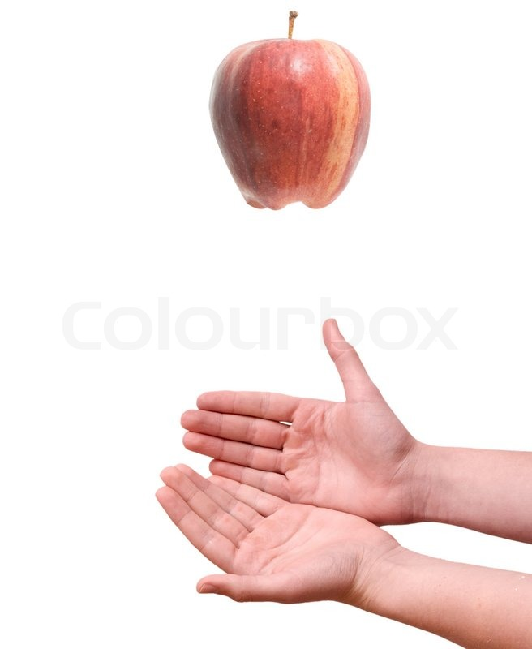
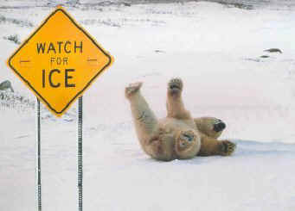


Concepts and Game Ideas
Buoyancy
Friction
Gravity
Light

Slide 5
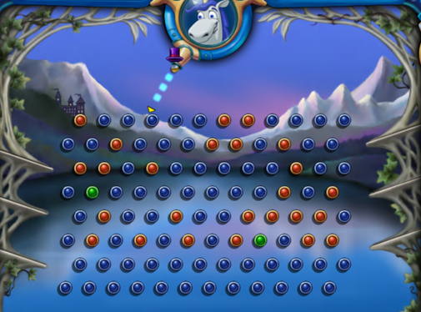
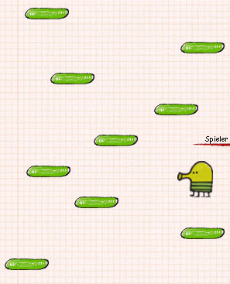
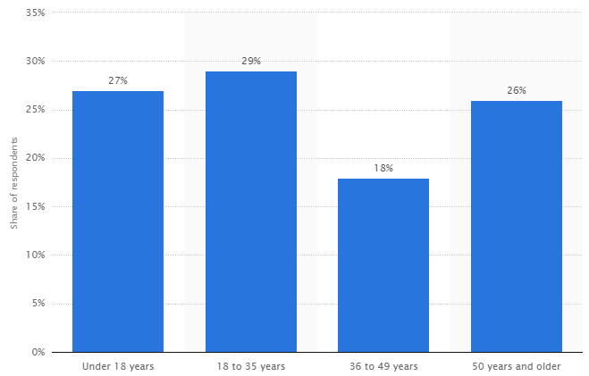
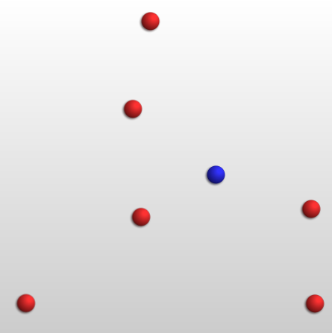
Research and Demographic
Established demographic of mostly males aged 12 – 35
Colourful
Vibrant
Minimalist or smooth
https://www.statista.com/statistics/189582/age-of-us-video-game-players-since-2010/

Slide 6
Game Mechanics
Initially friction based.
No unpredictability.
Bouncing mechanic.
Player character movement/control.
Randomised bouncing eggs.

Slide 7
Game Mechanics
Images, diagrams, gifs

Slide 8
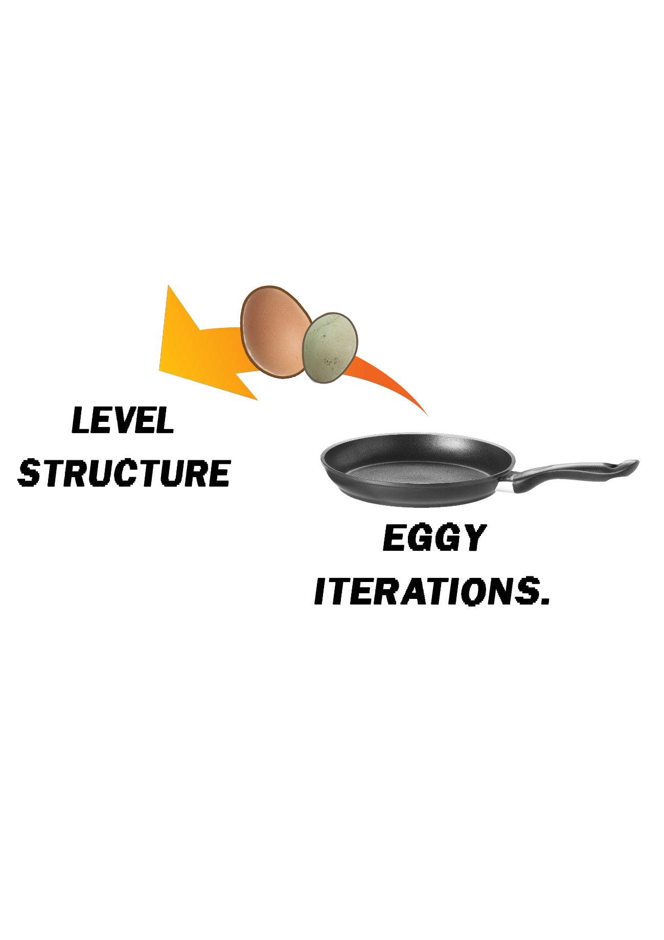
Level Structure
Based on a sequence of 5 levels
Each level calls for random level of set difficulty
Difficulty scales with level number

Slide 9
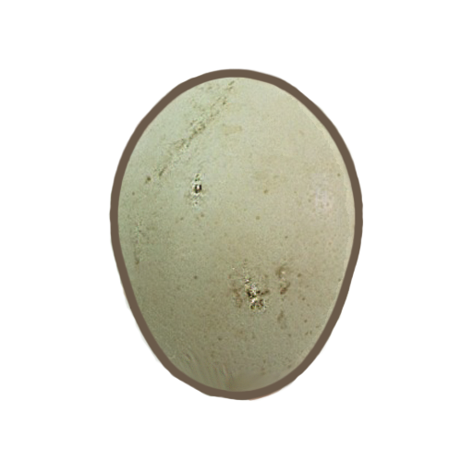

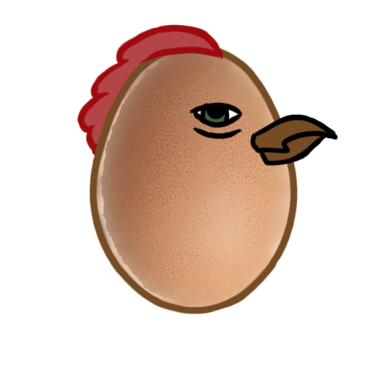
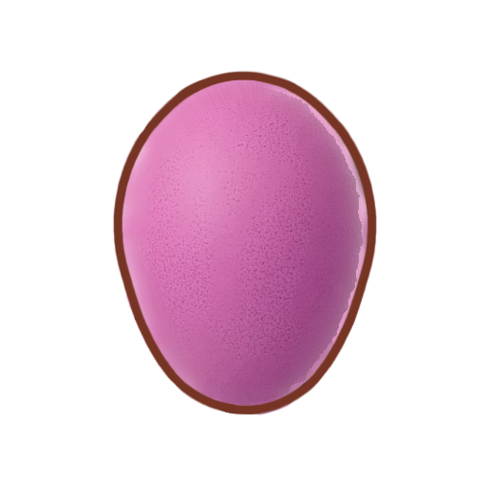



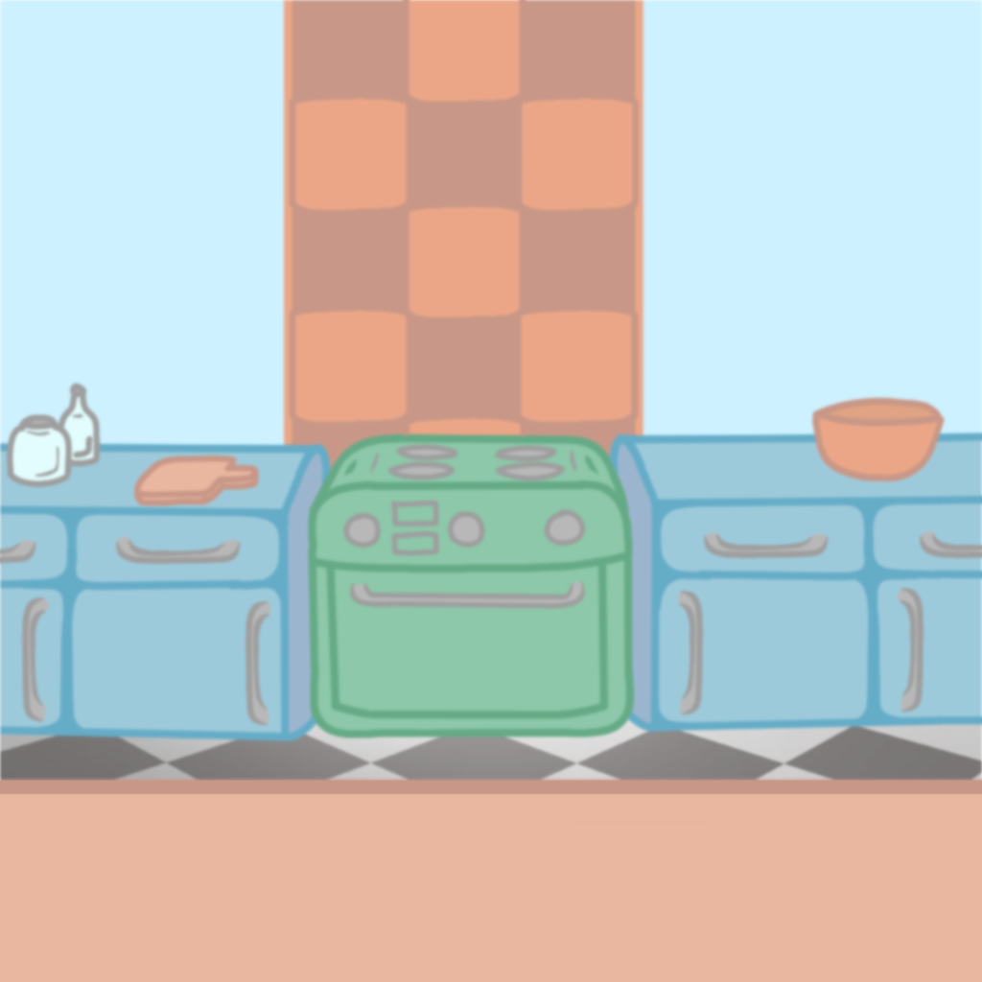
Art Assets

Slide 10
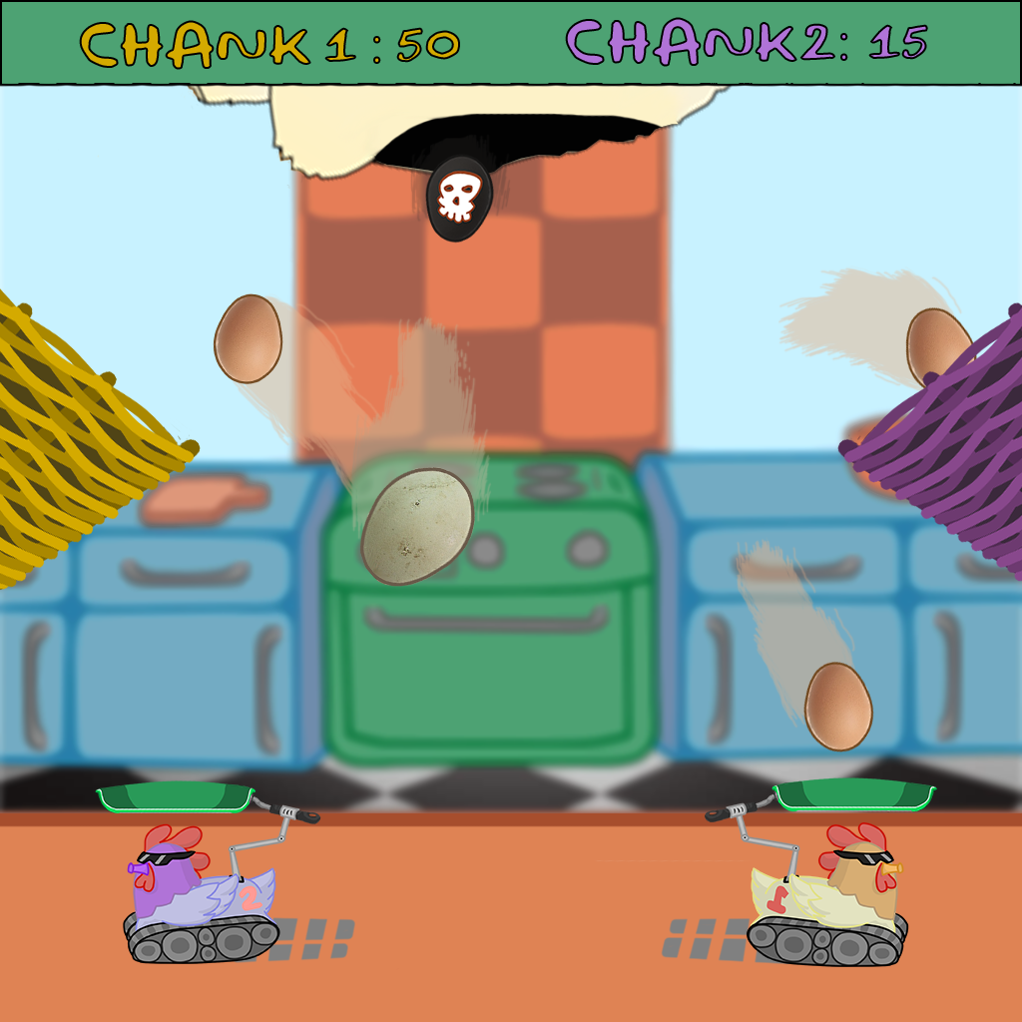
Mockup

Slide 11

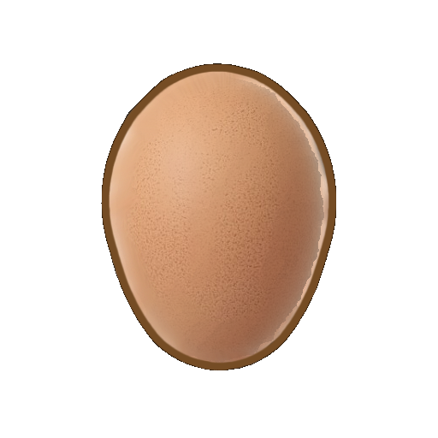

Replay Value
Trophies
High Scores
5 Level Structure
“Omelettin’ this slide”
“Omelettin’ this slide!”
“Cracking!”
“Shell shock!”

Slide 12
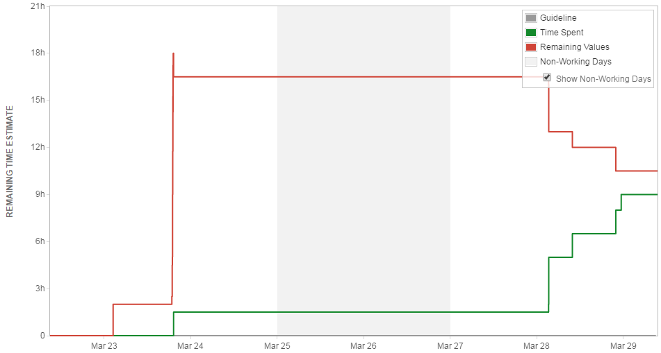
Email & JIRA
Emails this week:
Max – 10 Ross – 5 Jake – 2 Jack - 3

Slide 13
Questions?

